Slide 1

CS 533 INTRO TO DATA SCIENCE
Michael Ekstrand

Slide 2
REGULARIZATION

Slide 3
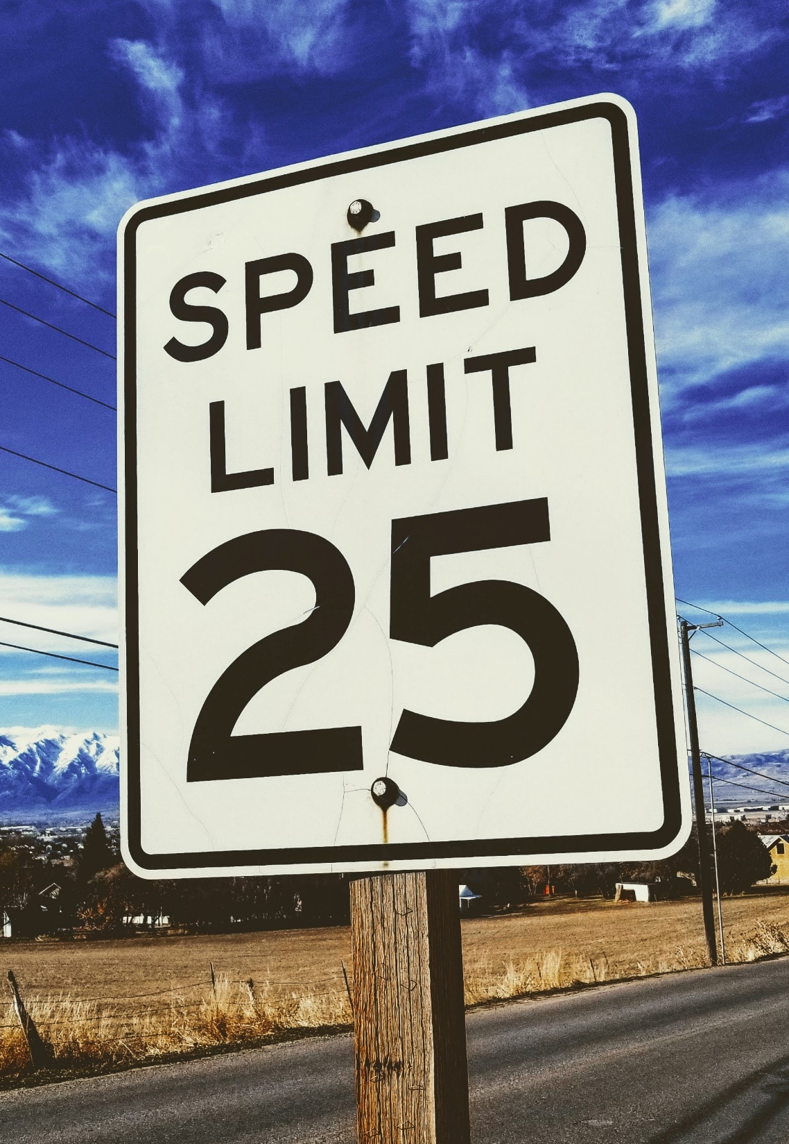
Learning Outcomes
Understand the function of a regularization term in a loss function
Apply regularization to logistic regression models
Tune regularization parameters
Photo by Joshua Hoehne on Unsplash

Slide 4

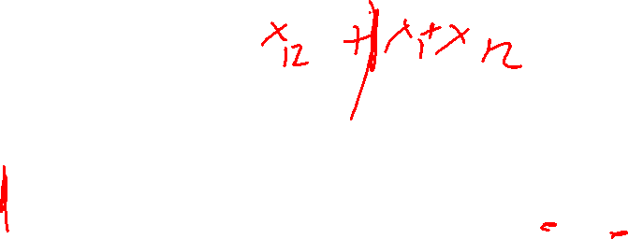
Multicollinearity
Correlated predictors cause poor model fit
X₁
X1 causes X2?
X2 causes X1?
X? causes X1 and X2?
$$\hat{y}=β_{0}+β_{1}x_{1}+β_{2}x_{2}$$
Which coefficient gets the common effect?
Y
X₂

Slide 5
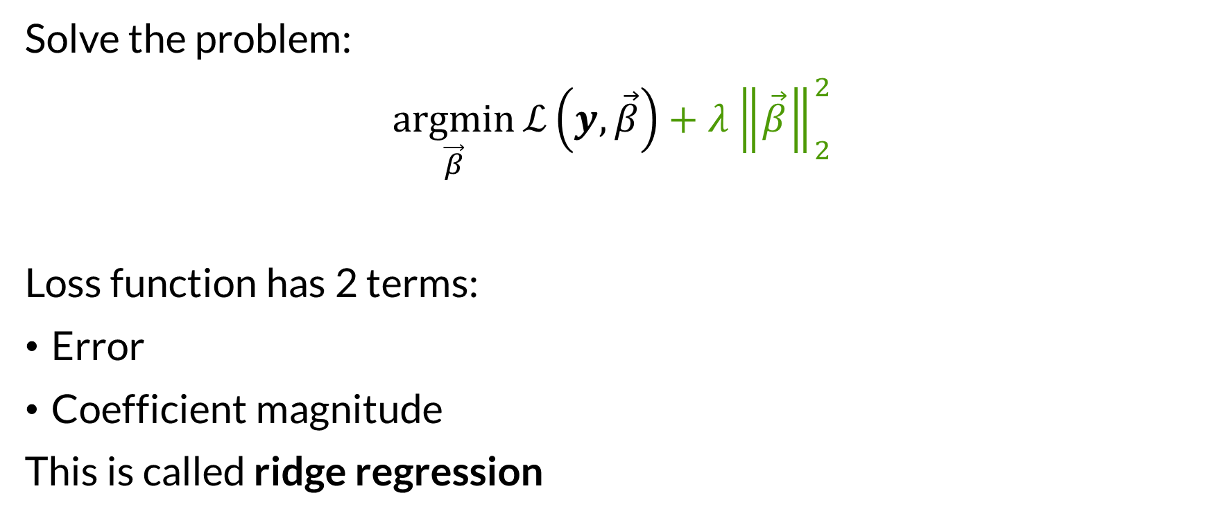
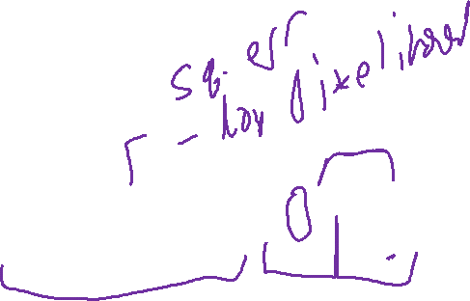
Loss and Regularization
Solve the problem:
$$\underset{\vec{β}}{argmin}{ℒ\left(y, \vec{β}\right)+λ{\left\|\vec{β}\right\|}_{2}^{2}}$$
Loss function has 2 terms:
Error
Coefficient magnitude
This is called ridge regression

Slide 6
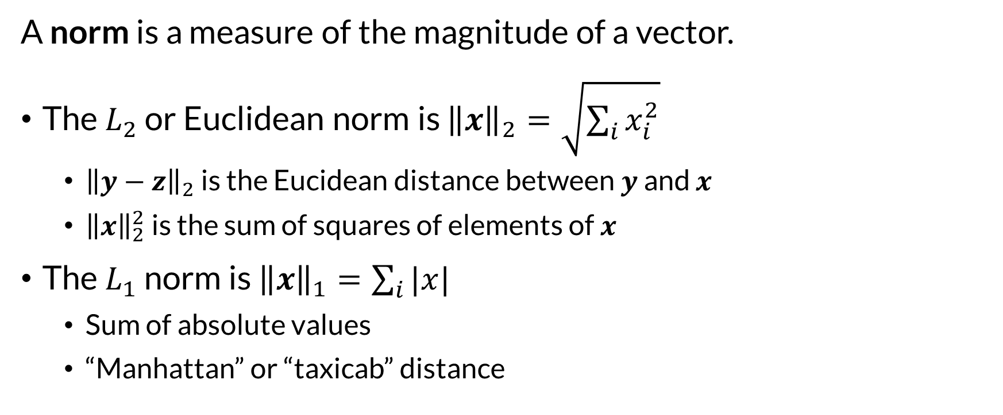

Vector Norms
A norm is a measure of the magnitude of a vector.
The $L_{2}$ or Euclidean norm is ${\left\|x\right\|}_{2}=\sqrt{\sum_{i}{x_{i}^{2}}}$
${\left\|y−z\right\|}_{2}$ is the Eucidean distance between $y$ and $x$
${\left\|x\right\|}_{2}^{2}$ is the sum of squares of elements of $x$
The $L_{1}$ norm is ${\left\|x\right\|}_{1}=\sum_{i}{|x|}$
Sum of absolute values
“Manhattan” or “taxicab” distance

Slide 7
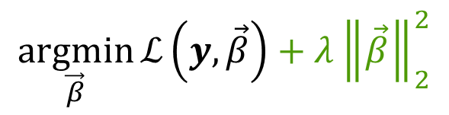

Understanding Regularization
How do you increase loss?
Increase a coefficient
How does that happen?
Strong relationship
More of the common factor on one than another
$$\underset{\vec{β}}{argmin}{ℒ\left(y, \vec{β}\right)+λ{\left\|\vec{β}\right\|}_{2}^{2}}$$

Slide 8
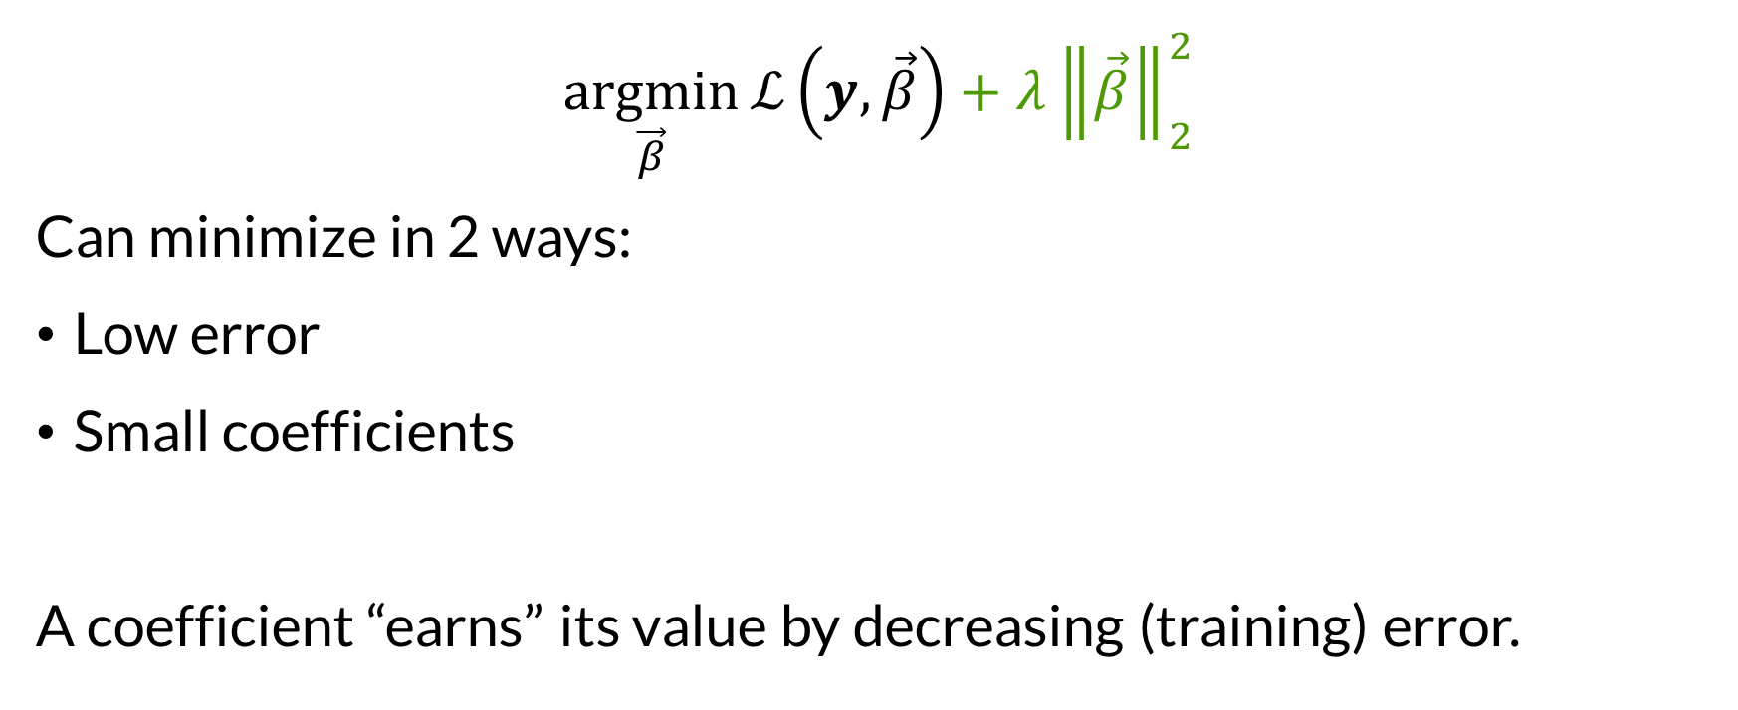

Balancing
$$\underset{\vec{β}}{argmin}{ℒ\left(y, \vec{β}\right)+λ{\left\|\vec{β}\right\|}_{2}^{2}}$$
Can minimize in 2 ways:
Low error
Small coefficients
A coefficient “earns” its value by decreasing (training) error.

Slide 9
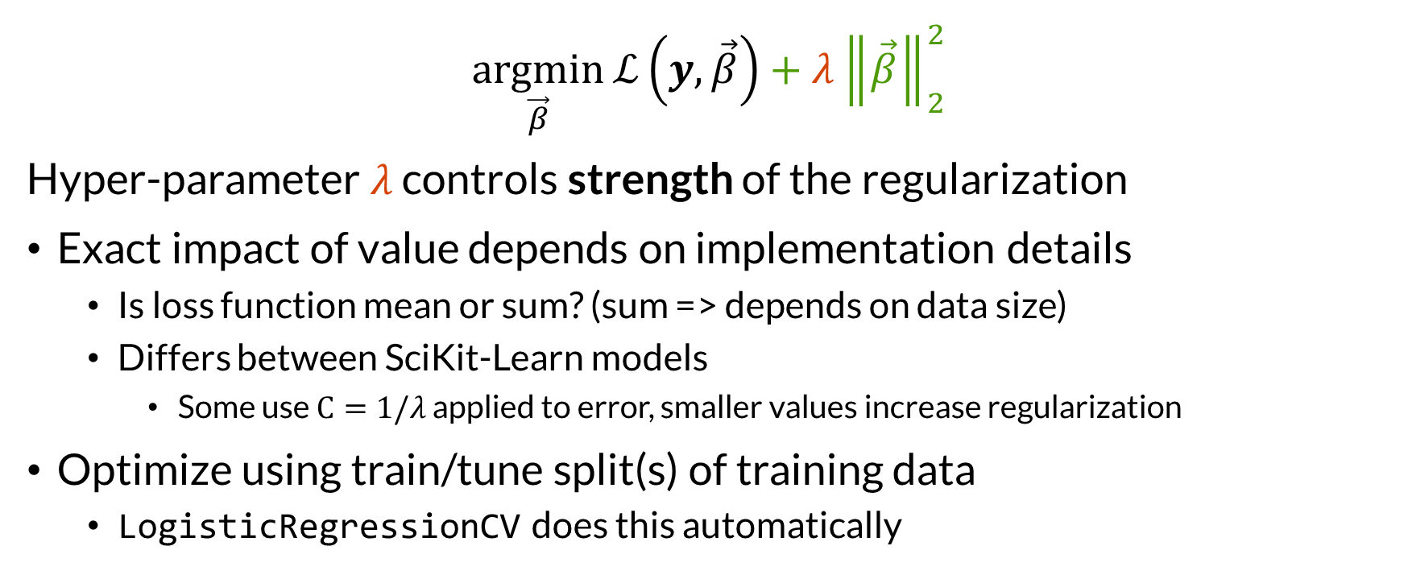

Regularization Factor
$$\underset{\vec{β}}{argmin}{ℒ\left(y, \vec{β}\right)+λ{\left\|\vec{β}\right\|}_{2}^{2}}$$
Hyper-parameter $λ$ controls strength of the regularization
Exact impact of value depends on implementation details
Is loss function mean or sum? (sum => depends on data size)
Differs between SciKit-Learn models
Some use $C=1/λ$ applied to error, smaller values increase regularization
Optimize using train/tune split(s) of training data
LogisticRegressionCV does this automatically

Slide 10
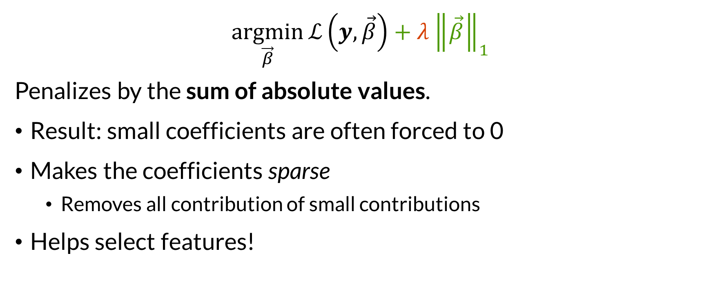

Lasso Regression
$$\underset{\vec{β}}{argmin}{ℒ\left(y, \vec{β}\right)+λ{\left\|\vec{β}\right\|}_{1}}$$
Penalizes by the sum of absolute values.
Result: small coefficients are often forced to 0
Makes the coefficients sparse
Removes all contribution of small contributions
Helps select features!

Slide 11
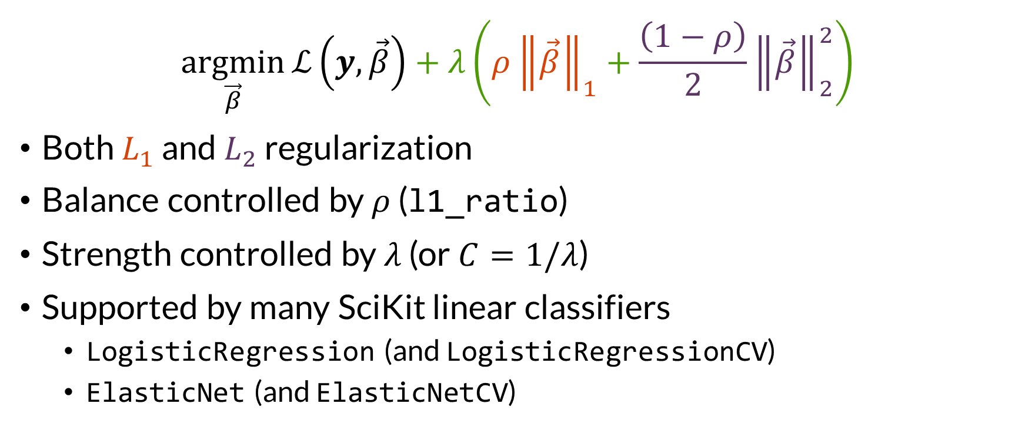

The Elastic Net
$$\underset{\vec{β}}{argmin}{ℒ\left(y, \vec{β}\right)+λ\left(ρ{\left\|\vec{β}\right\|}_{1}+\frac{\left(1−ρ\right)}{2}{\left\|\vec{β}\right\|}_{2}^{2}\right)}$$
Both $L_{1}$ and $L_{2}$ regularization
Balance controlled by $ρ$ (l1_ratio)
Strength controlled by $λ$ (or $C=1/λ$)
Supported by many SciKit linear classifiers
LogisticRegression (and LogisticRegressionCV)
ElasticNet (and ElasticNetCV)

Slide 12
Applying Regularization
Standardize numeric first
Coefficient strengths are comparable
0 is neutral, coefficient magnitude is strength of relationship
Select hyperparameters based on performance on tuning data
Scikit-Learn CV classes help with this
See notebook for example

Slide 13

Wrapping Up
Regularization penalizes large values of coefficients.
This controls model structure and, combined with standardization, requires “strong” beliefs in relationships to be justified by reducing training error.
Photo by Jasper Garratt on Unsplash

